Slide 1
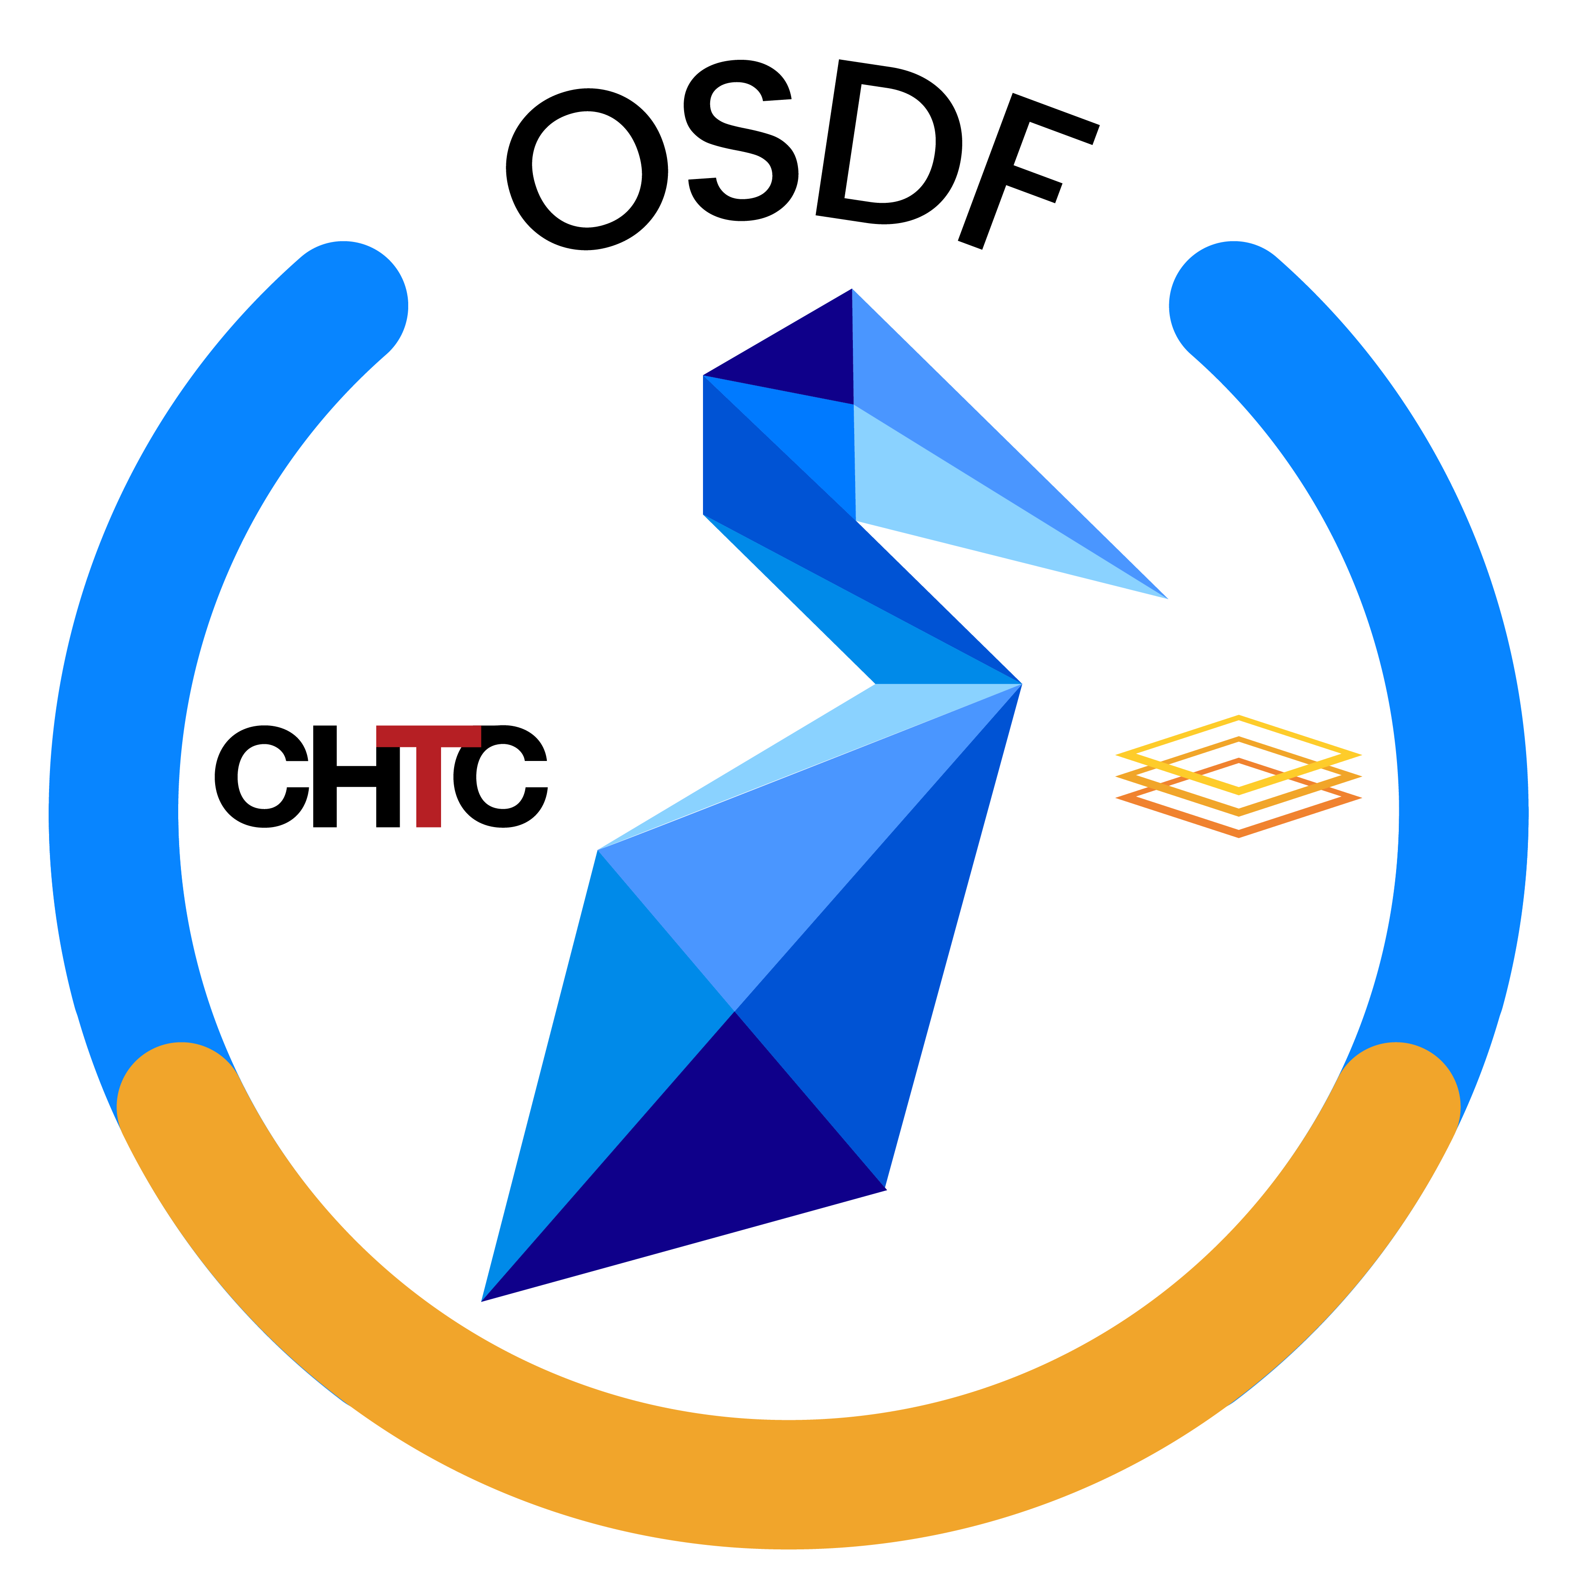

Dear CICI PI:
Let’s Be Partners
Brian Bockelman
Morgridge Institute for Research

Slide 2
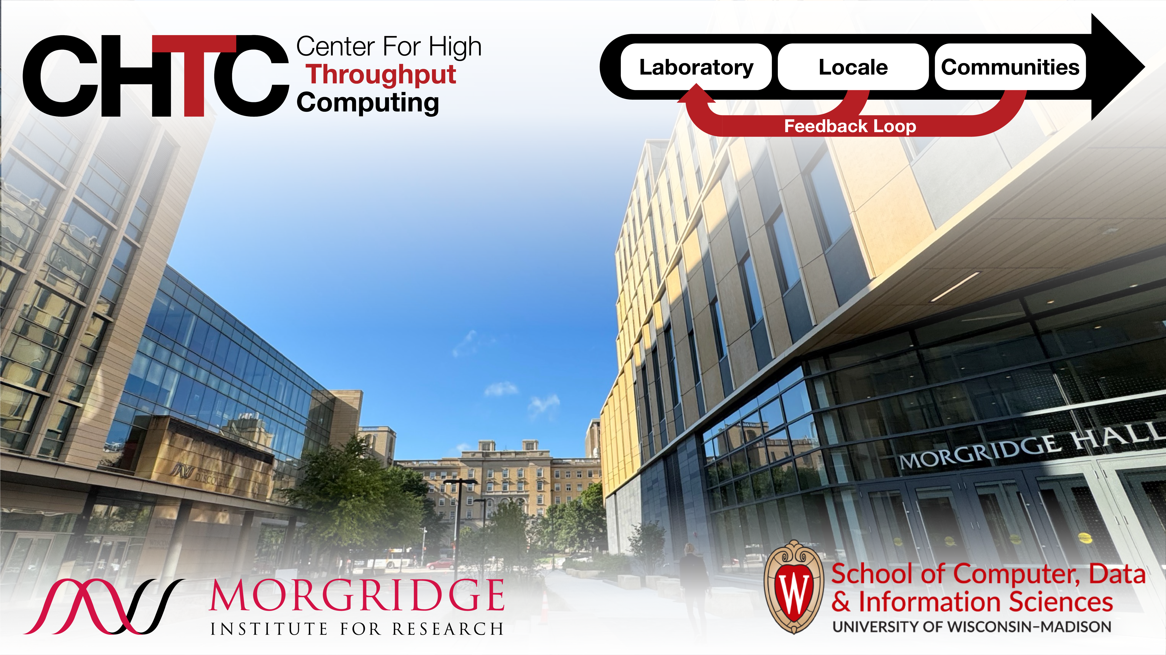

Slide 3
Have you ever been frustrated by (scientific) data?
It is real work to curate a scientific dataset, including metadata and grow community interest in it!
But, as a PI, your work is not yet done:
What tools do you provide to use the data?
How do you manage access control?
How do you connect your community to computation?
How do you provide scalable access to the data?
  S3 scales: but S3 egress fees can kill!
  … and S3 “user pays” is not loved!

Slide 4
Option 1: Dear User, it’s Your Problem
You can shift the problem to the user community:
Put the data on your university web server / S3, create a website, tell your friends about it.
Not my problem to provide you with compute!
You figure out how to download the data.
  You write the scripts to have curl scrape the website.
  And figure out where to copy the data. And get the updates.
  And figure out where to compute.
Why not? Simple: higher friction to use => smaller impact.

Slide 5
Option 2: Dear User, We’ll Do It!
Scale out the data repository.
Build tools to distribute the data.
Build a platform (gateway?) for computing on the dataset.
Build your authentication and authorization solution.
Build build build …
Problem: At some point you have to do the science!
Curating data is hard enough:
Isn’t there a better way?

Slide 6
Option 3: Leverage the NSF ecosystem
You understand your dataset better than anyone. However,
Some of these problems are common across domains!
NSF funds services that help stream your data (OSDF).
NSF funds services to catalog & publish datasets (NDP).
NSF funds computing platforms to explore & analyze data (OSPool, NRP).
NSF funds service platforms for providing unique capabilities specific to your dataset (NDP, NRP).
You can build the community & provide value – without the DIY!

Slide 7


What is the ?
… By Analogy…
+
“Netflix for Science”
Allowing computational workloads to stream data

Slide 8
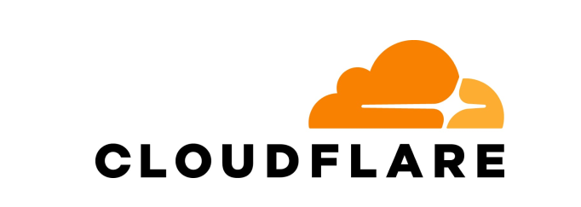
What is the ?
… By Analogy…
+
“Cloudflare for Science”
Infrastructure for scaling access to your storage

Slide 9
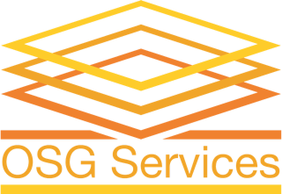
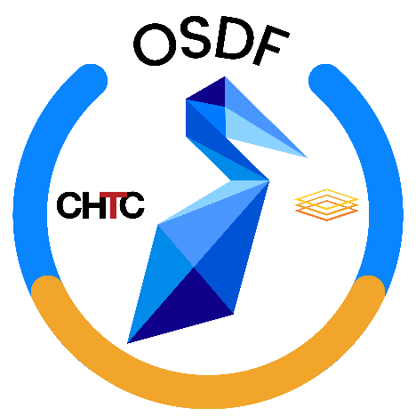
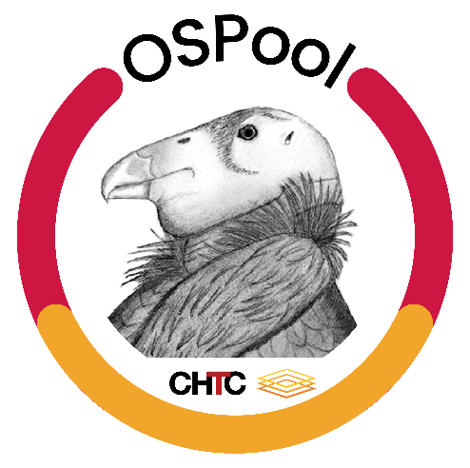











Serving an (Inter)national Community
OSFacilitate

Slide 10

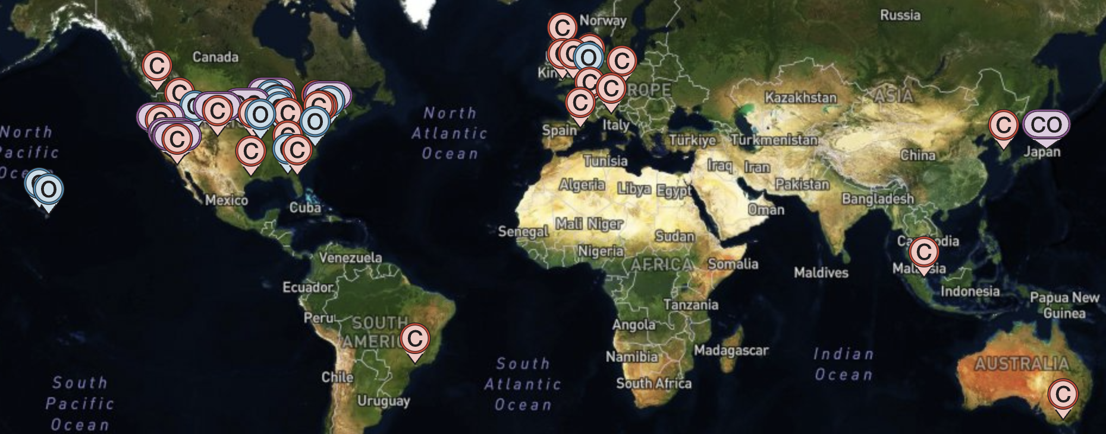
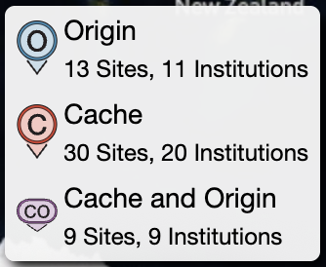
OSDF In Detail
The OSDF is a global service for data delivery
  Operated by the PATh project
  Using software from the Pelican Project
  Leveraging hardware from the NRP, Internet2, ESNet, and more!

Slide 11
Connecting to the OSDF
This is where your data lives
Object Store
The place where your data lives is the “object store”
  This can be a POSIX filesystem, S3-compatible, HTTP webserver, or Globus collection.
  Exports immutable objects in your dataset.
We – or you! - operate the origin service, a container that connects the object store to the OSDF.
  The origin implements your access control policies and proxies .
The rest of the OSDF scales via reuse and manages access.
Implements your access policies!
Origin Service
Global OSDF Service

Slide 12
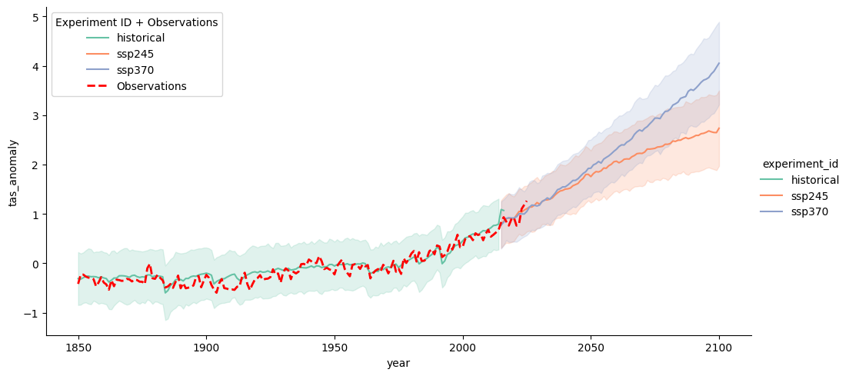
Researcher uses a Jupyter Notebook to create a visualization that requires two objects:
NCAR
OSDF Director
(Namespace)
AWS
Open Data
NCAR
AWS-Open
Data
OSDF Origin
(AWS-Opendata/US-west-2)
OSDF Origin
(NCAR)
US-West-2
OSDF Cache
Jupyter Notebook
[1] Pelican Get (OSDF, NCAR/…
Pelican Client
[2] Pelican Get (OSDF, AWS-…
[3] Visualize (…
NCAR/ rda/harshah/osdf_data/HadCRUT.5.0.2.0.analysis.summary_series.global.monthly.zarr
rda/harshah/osdf_data/HadCRUT.5.0.2.0.analysis.summary_series.global.monthly.zarr @ NCAR Object Store
- cmip6-pds/CMIP6/CFMIP/NCAR/CESM2/aqua-4xCO2/r1i1p1f1/Amon/co2mass/gn/v20190816 @ AWS Open Data Object Store
AWS-OpenData/US-West-2/cmip6-pds/CMIP6/CFMIP/NCAR/CESM2/aqua-4xCO2/r1i1p1f1/Amon/co2mass/gn/v20190816

Slide 13
How to leverage the OSDF?
The OSDF is not some dusty disk-based FTP server in the cloud!
The OSDF is not a “free S3”!
How can your community use the service effectively?

Slide 14
OSDF’s value for a CICI PI:
Stream your data to your user community => Saves your project $$$
Implement your authorization policy => Saves your project time
Tracks usage data => Saves you PI time
Allow users to use NSF compute to scale => Grows your community
Important note: If you do not have a location to store a disk copy of the dataset, PATh can also host a time-limited copy via the sister OSStore service.

Slide 15
Integrating Datasets with the OSDF

Slide 16
Recipe #1: NCAR
Scenario: NCAR has a big S3 instance with petabytes of public datasets it wants to effectively distribute to large community.
  Transition community from “download then compute” to “stream to compute”.
Solution:
  PATh deployed an origin service, pointing at NCAR’s on-prem S3 instance.
  All data (objects) in the bucket are exported to OSDF via the origin.
  NCAR updated their online portal to provide HTTP download links to OSDF.
  NCAR updated sample Jupyter notebooks to use Pelican Python client instead of assuming locally-downloaded data.
Example: Collaborators in Korea now leverage local cache instead of streaming from across the planet.

Slide 17
NCAR Setup
NCAR
OSDF
Science DMZ
S3 instance
HTTP GET
Origin Service
HTTP GET
Cache Service
HTTP GET
Client
Important note: the origin service can also be hosted externally in Internet2; need not be on campus.

Slide 18
New Feature #1:
AWS Caching
Coming October 2025
What if NCAR’s data lived in AWS S3, not on-prem?
In that case, streaming publicly can be very expensive.
But NSF funds significant compute outside AWS! How to manage egress costs?
OSDF can operate the origin in the NRP and attach large (slow) storage
Data egresses once!

Slide 19
Alternate Setup
OSDF
AWS
Internet2 POP
S3 instance
HTTP GET
Origin Service
HTTP GET
Cache Service
HTTP GET
Client
This configuration (available in a few months) makes a copy of the objects at the origin & external to AWS, helping to manage egress costs.

Slide 20
Recipe #2: FlamingoSim @ KSU
Scenario: PI at Kennesaw State University (Ramazan Aygun) wants to share a single dataset “FlamingoSim”, located on a shared filesystem, with his collaborators.
Solution:
  PATh deployed an origin service on a host with the filesystem mounted.
  PATh configures the origin to only authorize specific collaborators to download data.
  Authentication is done via their institution’s Single Sign On (no new user accounts!) using CILogon.
  Ramazan hands collaborators the OSDF object names and teaches them to use the pelican CLI to download files.

Slide 21
FlamingoSim @ KSU Setup
KSU
OSDF
Science DMZ
Filesystem
HTTP GET + token
Origin Service
POSIX
read()
Cache Service
Get credential
HTTP GET + token
Client
Not shown: To acquire the credential from the origin, the user must authenticate to their home institution’s SSO (or ORCID) in a browser.

Slide 22
New Feature #2:
Self-Service Group Management
Available now!
PATh currently configures the authorization policies for FlamingoSim to match the PI’s requests.
  Pro: Uses institutional SSO, simple for user.
  Con: Requires a different human to change settings!
Datasets can now be onboarded using group-based access.
Dataset owners can add or remove collaborators via the web portal.
  Portal uses the Comanage software operated by CILogon.
This fall: self-service APIs/web portal for more fine-grained access, simplifying process of publishing many datasets.

Slide 23
Portal Integration & Advanced Topics
Each community tends to have unique authorization setups:
If there’s an existing web portal, it can generate the authorization token directly and embed it into a URL (a-la S3’s pre-signed URLs).
Options exist for direct creation of long-lived credentials for automation and web browser-based flows: talk to us!
Under the hood, OSDF is “just” HTTPS:
Instead of using our tools, you can create a HTTPS URL for your users.
  If it speaks HTTPS, it can leverage OSDF! Opens a world of possible integrations.
The simplest OSDF client is a browser!

Slide 24
Unlocking Value with the OSDF
What have existing communities done with the OSDF?

Slide 25
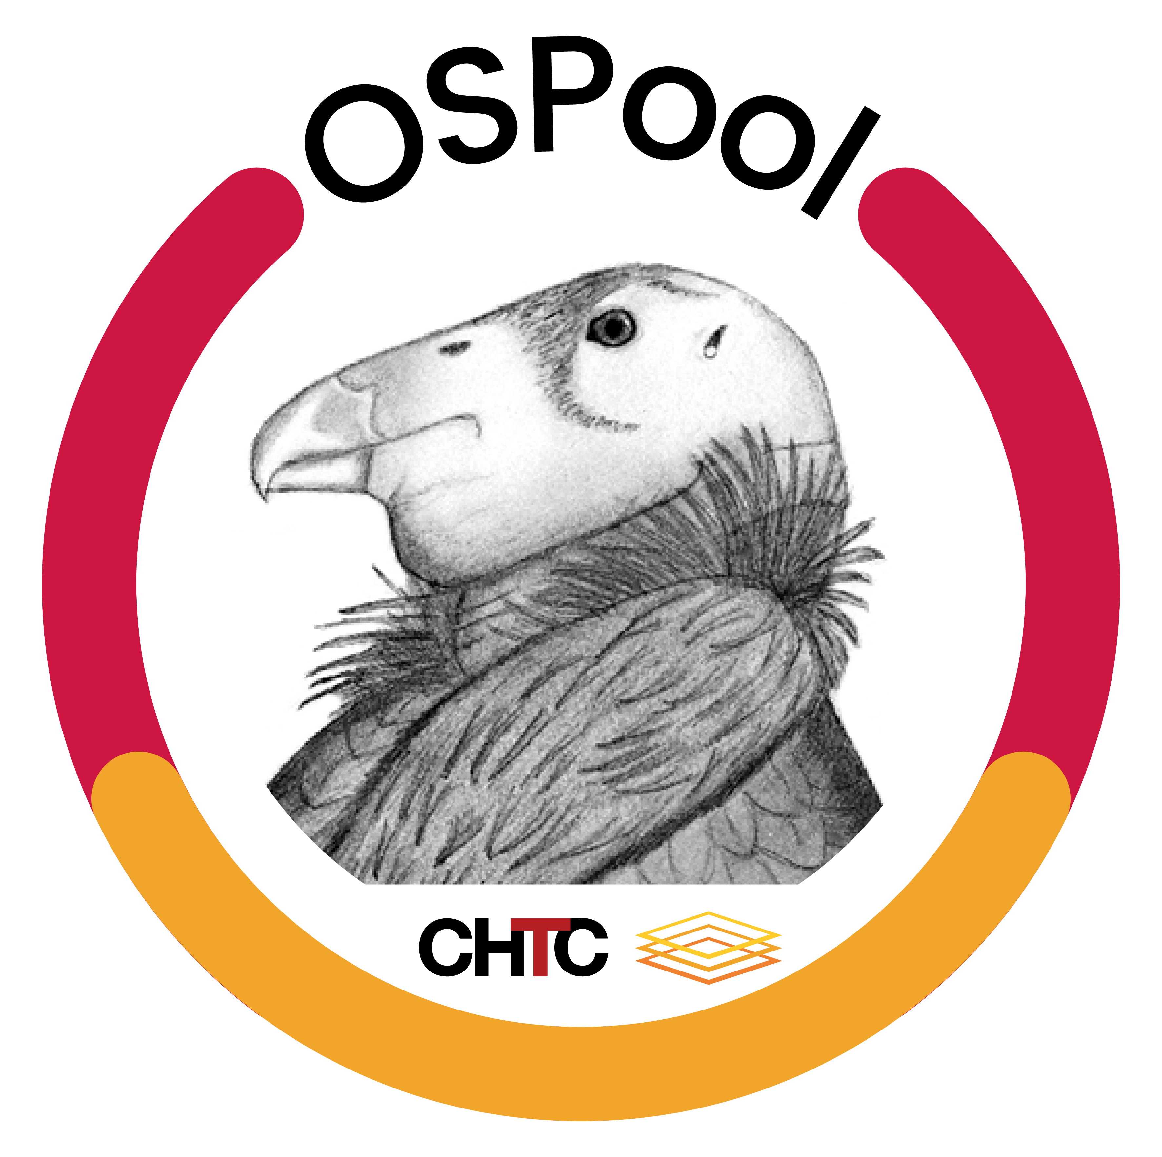
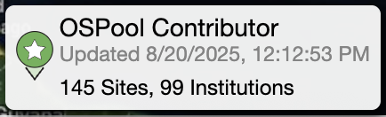
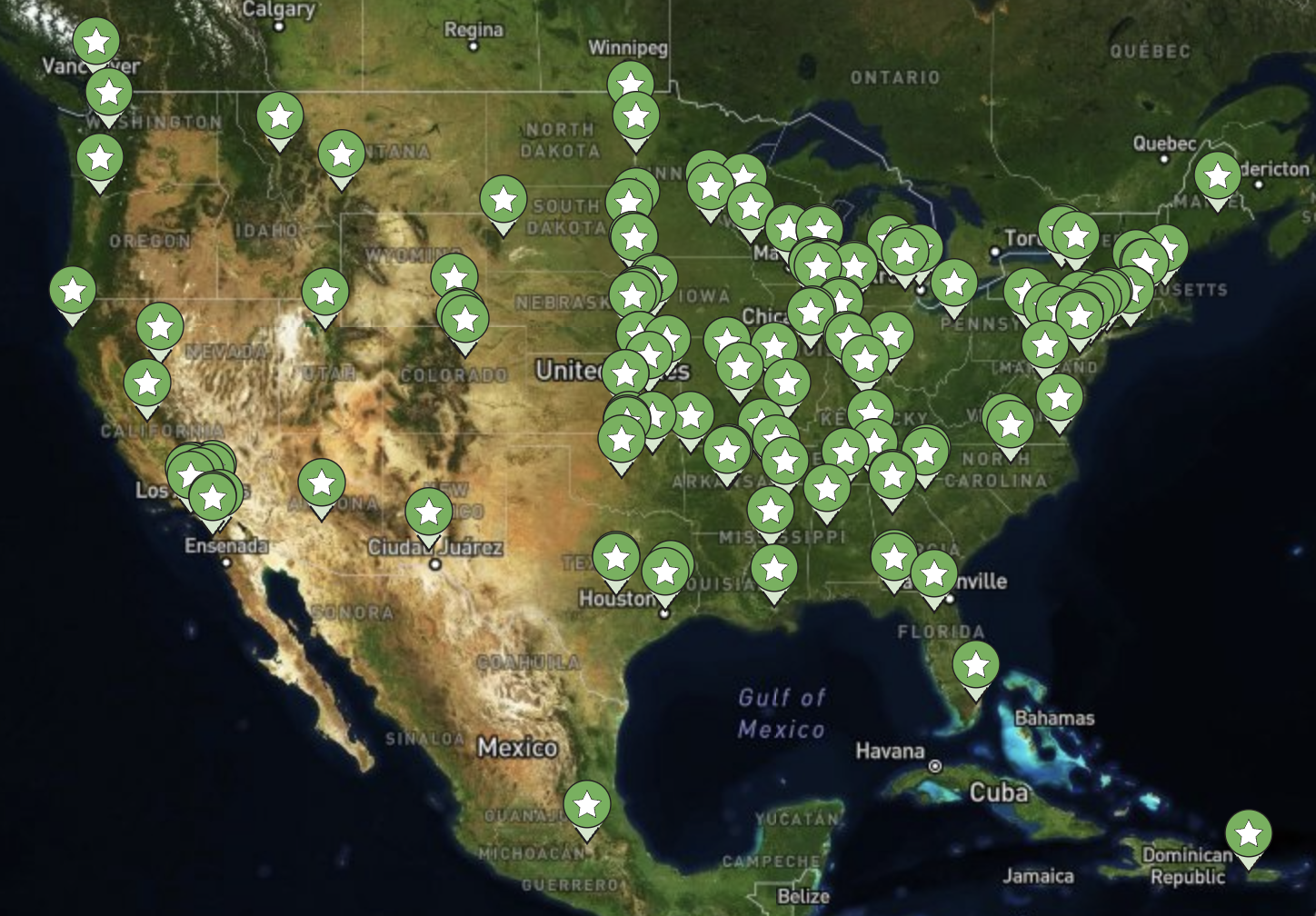
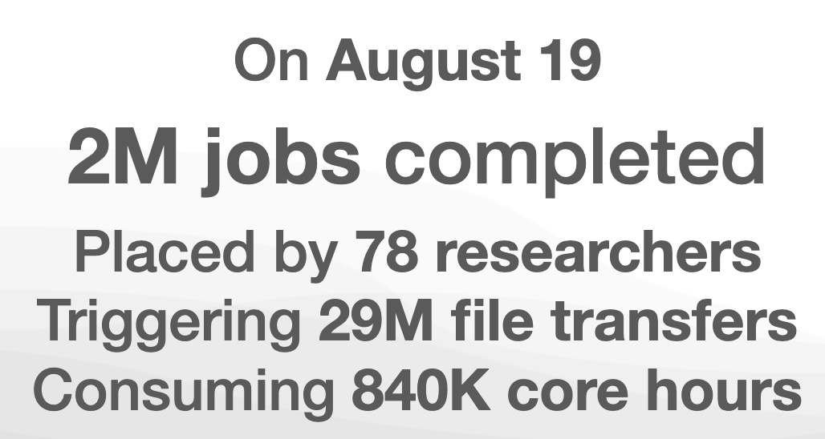
OSPool - Compute
Experience the OSPool environment at https://notebook.ospool.osg-htc.org/
The OSPool is a PATh-run service that aggregates compute capacity from across the nation into a single service.
Users can place their workloads at an access point and process inputs via the OSDF at scale.
On a typical day, >600K jobs take inputs from the OSDF.
~150 OSPool projects used the OSDF in the last year.
See more: https://osg-htc.org/services/osdf/projects
Give your users the “gift” of computing at scale on your dataset!

Slide 26
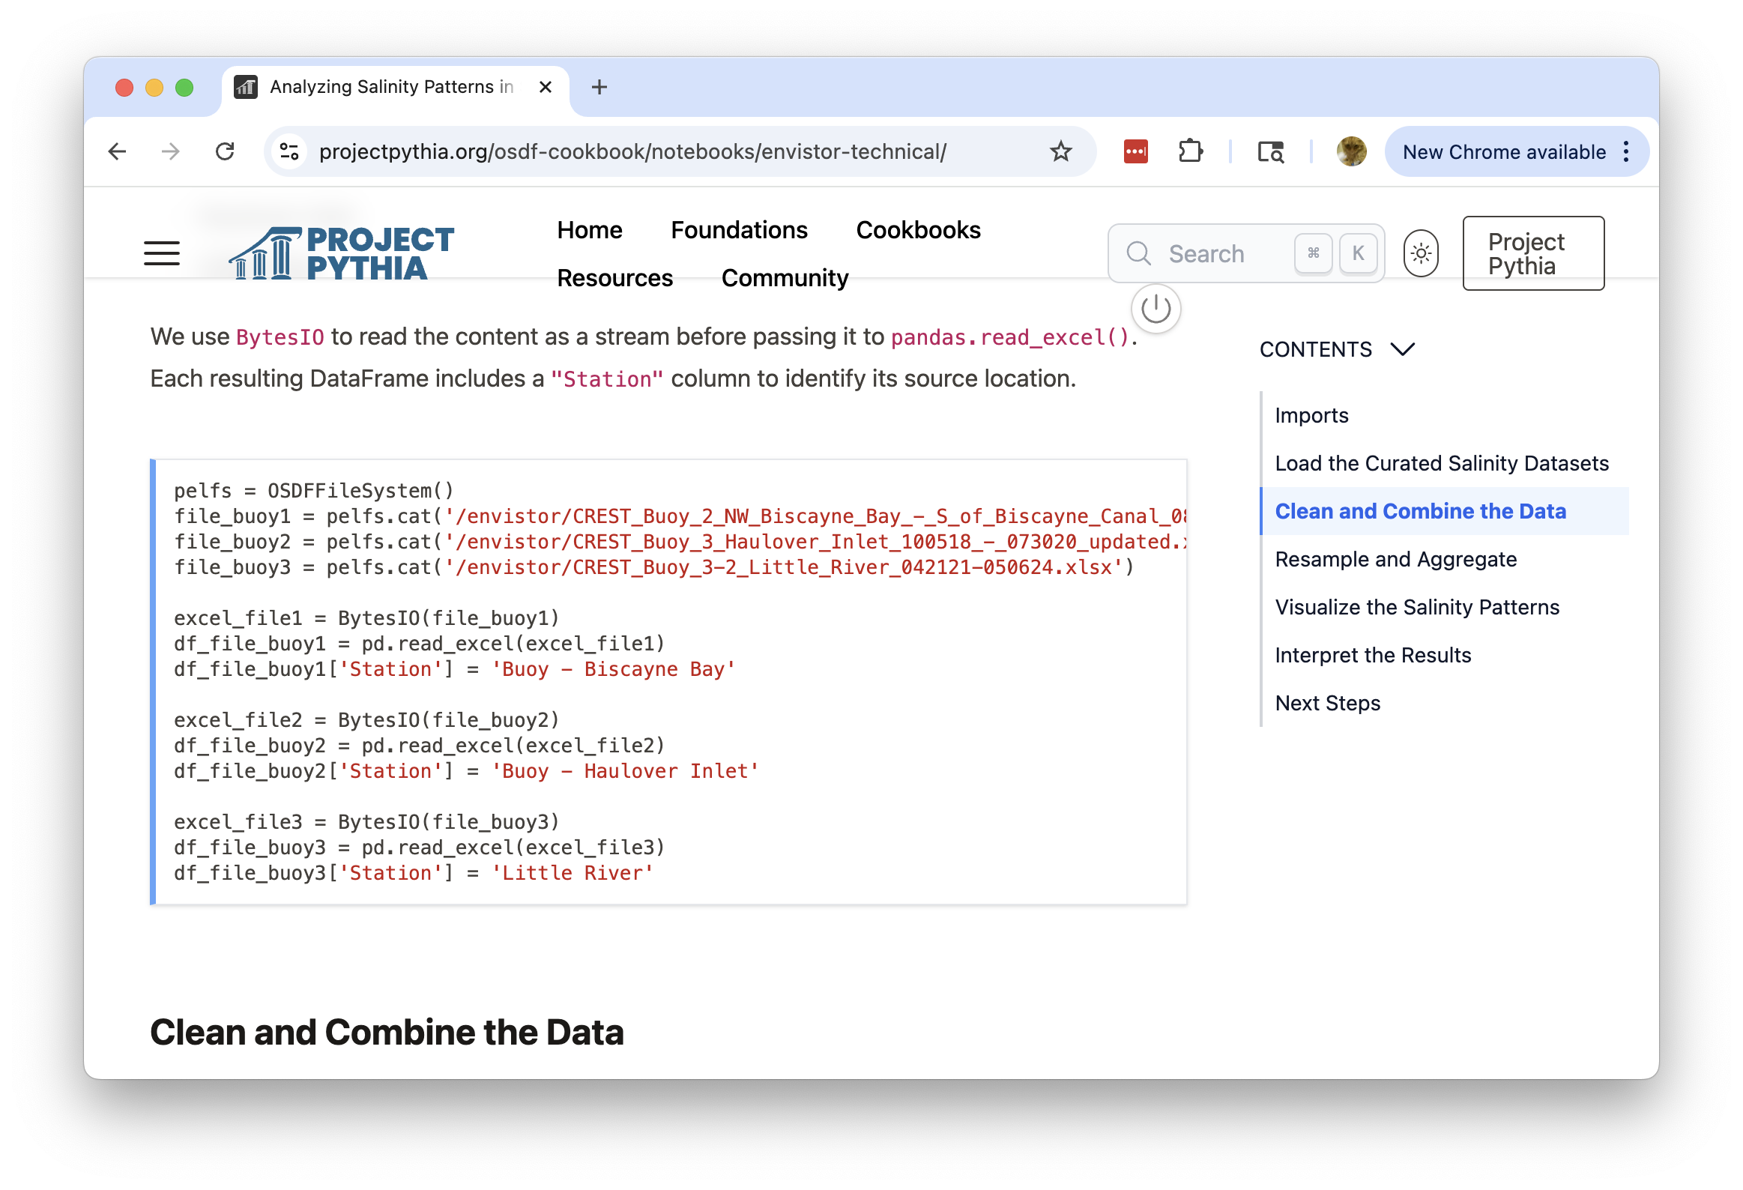
Notebooks - Visualize
OSDF can be accessed directly from a Jupyter notebook, using the Pelican Python library.
Libraries that support FSSpec (Pandas, XArray, Zarr, ) can stream from OSDF.
Don’t have a JupyterHub? Can always leverage the National Research Platform.
Need inspiration? Check out https://projectpythia.org/osdf-cookbook/

Slide 27
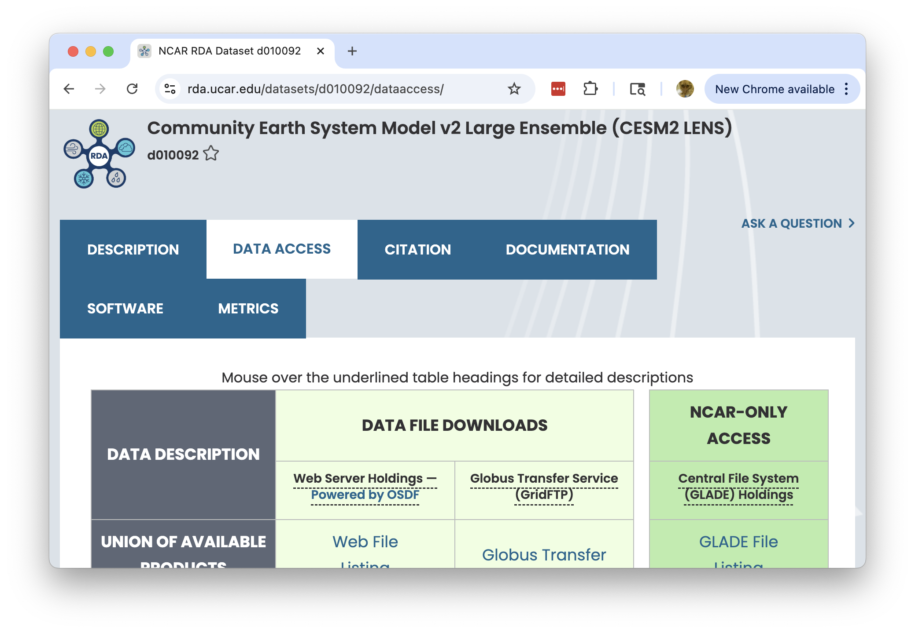
Browser - Download
You can use the fact OSDF is HTTP-based to embed URLs in your web portal – and combine your website with OSDF’s distribution!
NCAR does this for their RDA service.
Note: by adding credentials generated by the portal into the URL, you can leverage existing authorization.

Slide 28
What Next?

Slide 29
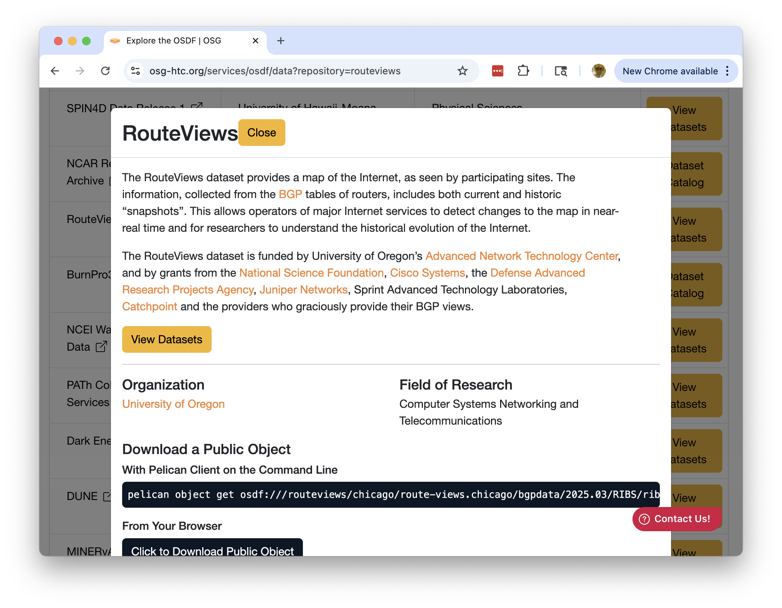
Browse Some Examples
Interested in what others have done?
We maintain a website highlighting various integrations and available datasets.
Includes sample public objects and links to further info.
Enjoy your RouteViews data!
https://osg-htc.org/services/osdf/data

Slide 30
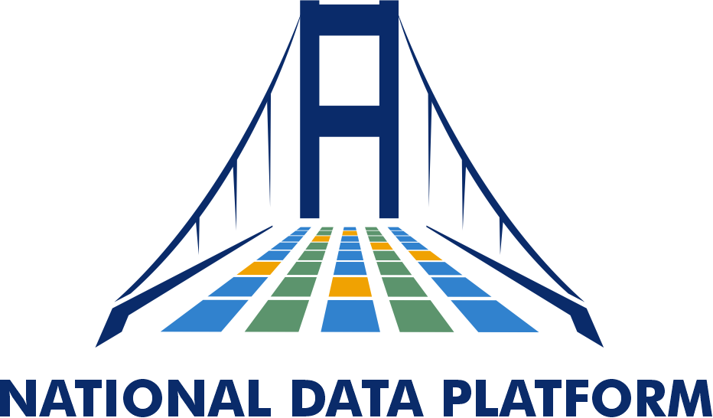
Leveraging more Data Services
What do you need beyond dataset delivery?
Building out Jupyter notebook-based cookbooks?
Building out a catalog of the published datasets?
Generating metadata to attach to the data?
Want a runtime environment for teaching classes?
Have some bespoke computation service needed for your data?
The next talk about the National Data Platform (NDP) covers these higher-level services!

Slide 31
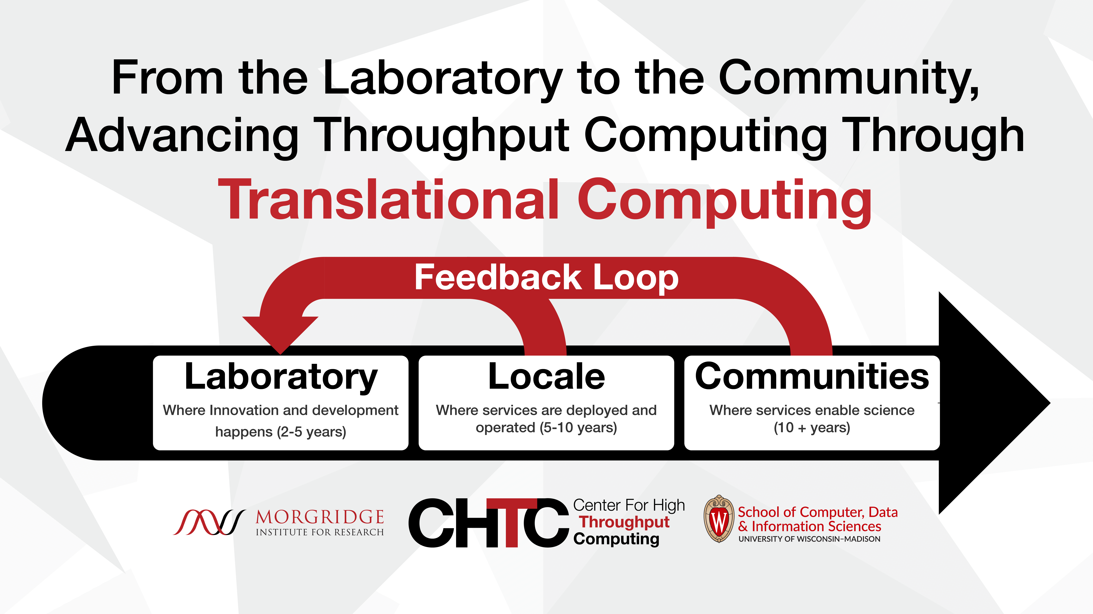
CHTC uses Translational Computer Science

Slide 32
Working with you is how we get our research done!
Translational CS requires a locale (the OSDF) to test out ideas and a community (CICI) to provide feedback
We are not doing this for altruism: Your feedback and partnerships are how we improve!

Slide 33
Questions?
Let’s work together:
https://path-cc.io/cici-awardees/
support@osg-htc.org
This project is supported by the National Science Foundation under Cooperative Agreements OAC-2331480. Any opinions, findings, conclusions or recommendations expressed in this material are those of the authors and do not necessarily reflect the views of the National Science Foundation.

Slide 34
Backup Slides

Slide 35



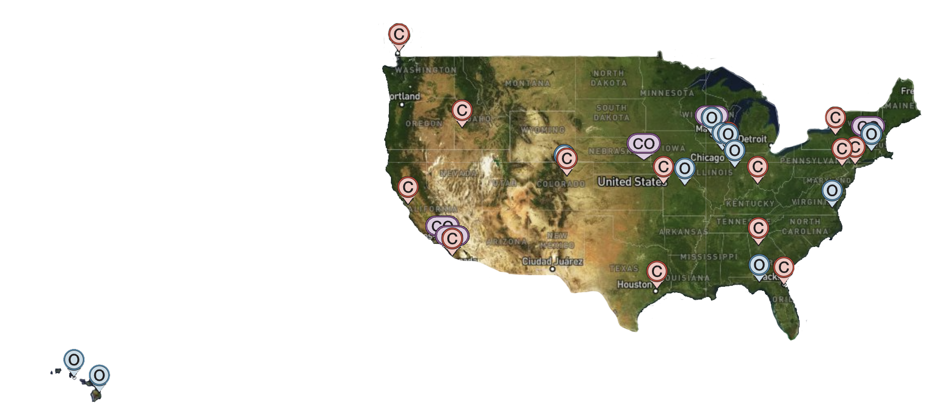
A national object delivery network
Operated by PATh (NSF #2030508)
OSDF is powered by the
Pelican software
(NSF #2331480).
Client
Who can benefit?
Open to any federally-funded science repository or object store.
Researchers can access/connect their data to local or national compute by browser or notebook
Data providers can share via FAIR principles.
Compute providers can cache datasets on-site
Community platform providers can build gateways and portals to large-scale datasets.
Features
No direct cost for integration.
Supports automation of data-intensive workloads
Unified name space preserves local autonomy
Unified authorization infrastructure for restricting object access.
Object
Consumer
Layer
Example use cases
Enable large-scale workloads that have significant reuse and redelivery of objects at remote autonomous object stores.
Manage loads on object stores and avoid egress costs via caching & staging.
DOE: FNAL (LHC, DUNE), JLab, Fusion
NOAA: Via AWS OpenData
NSF: NCAR, NRAO, LIGO, EHT
Key concepts
Object: both data & non-data objects (e.g., containers, models, libraries).
Object store: a filesystem, S3-compatible endpoint, or HTTP webserver.
Origin service: connects the backend object store with national infrastructure. Objects are read (GET) and written (PUT) through Origin.
Manager
Object
Caching
Layer
Object
Store
Layer
Origin
>140PB
moved
>3.5B
Objects delivered
34 caches throughout the world, at points of presence within major compute centers and the global R&E networks (ESNet, Internet2).

Slide 36
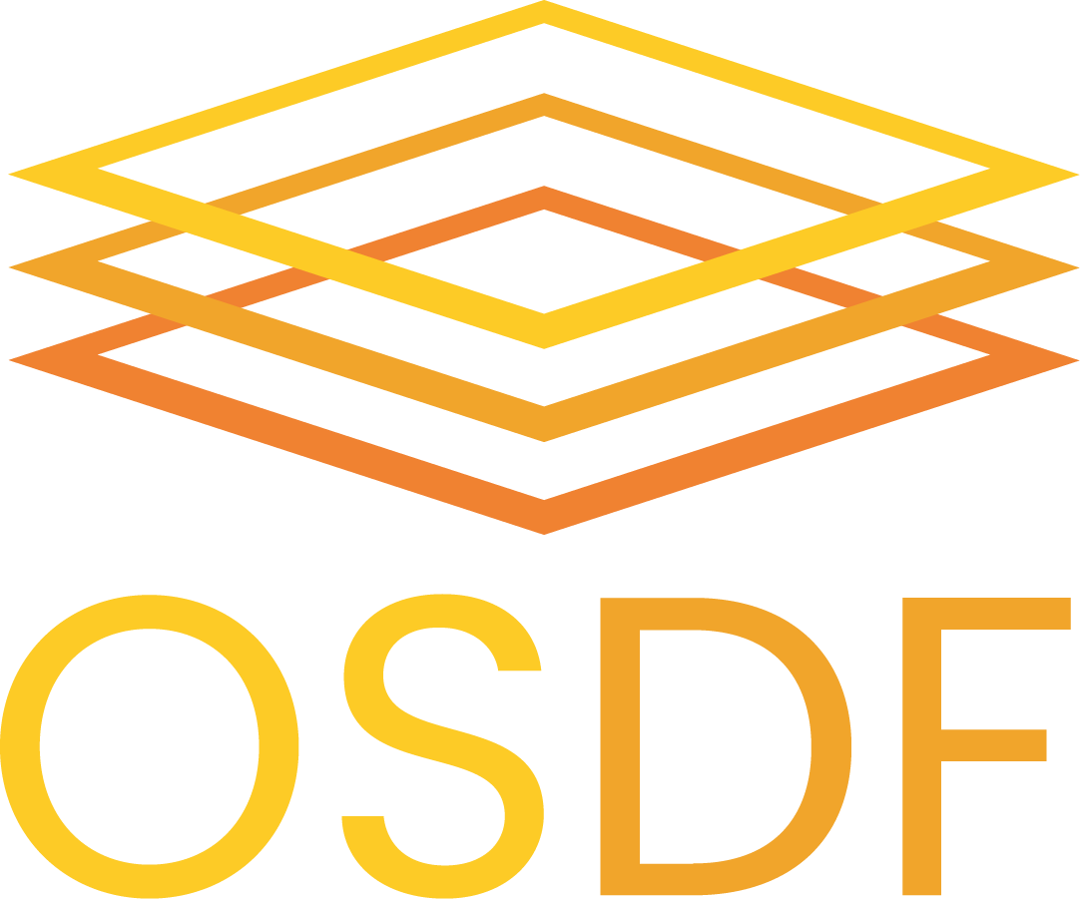



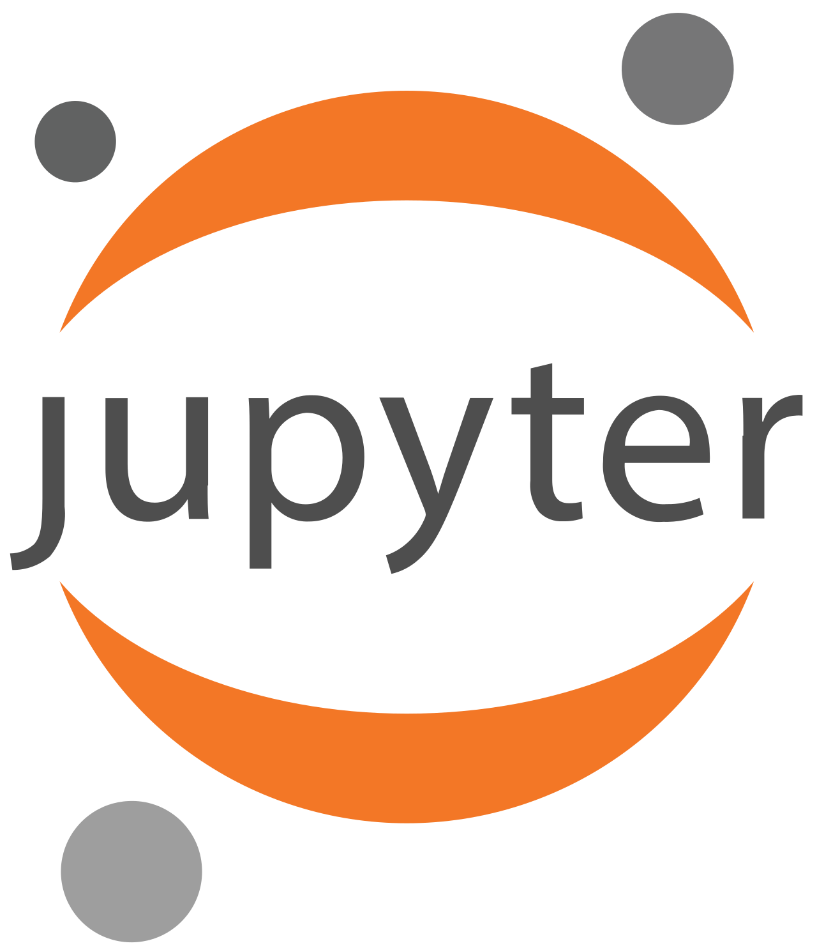
- Delivering Earth Systems data
Object Store Layer
NOAA Open Data Dissemination
The origin service connects storage to the OSDF.
Object Caching Layer
Data is cached for reuse, reducing the need for multiple egresses. Caches are embedded in the network.
The manager services coordinate the data access
Object Consumer Layer
Using a single toolset, researchers can fuse data from across multiple sources.
Integrates well with national compute capacity, Jupyter notebooks, or a browser

Slide 37
  “The Partnership to Advance Throughput Computing (PATh) project will expand Distributed High Throughput Computing (dHTC) technologies and methodologies through innovation, translational effort, and large-scale adoption to advance the Science & Engineering goals of the broader community.”
PATh Proposal 04/21/2020

